Slide 1
Modeling the Operations of Electric Autonomous Taxis in New York City
Liang Hu and Jing Dong
Presented at 2017 INFORMS Annual Meeting, Houston, TX
October 23, 2017

Slide 2
Why Electric Autonomous Taxis?
Ride
-
hailing
Electric
autonomous
Conventional taxis
vehicles (EAV)
Energy
source
•
gasoline
•
gasoline
•
electric
•
some electric
•
some electric
Search for
•
cruising
•
cruising
+ waiting
•
relocating
+ waiting
customers
•
by chance
•
drivers compete
•
collaborative
Customers’
•
optimal dispatch
delay
•
unknown to taxis
•
drivers do not care
•
reduce delay
Trip
•
taxis w/o sufficient
distance
•
unknown to taxis
•
unknown to taxis
range are not
assigned
Introduction | Simulation | Optimization | Results | Summary
Notes:
delete unknown

Slide 3
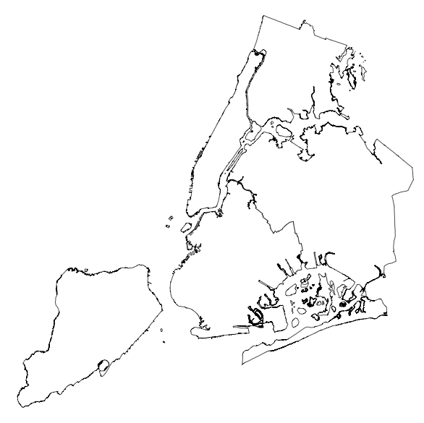


Model EAV Taxi Operations
t-2
t-1
t
Model operations based on status of both requests and taxis, over time, area by area
Requests
request time location wait time
EAV taxis
location SOC
Introduction | Simulation | Optimization | Results | Summary

Slide 4

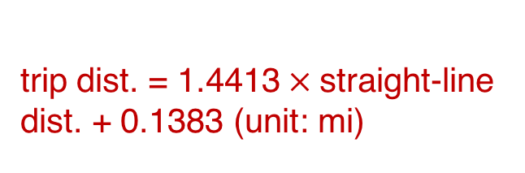
Taxi Trip Data in NYC
Data fields
taxi ID
pick-up GPS
pick-up timestamp
drop-off GPS
drop-off timestamp
occupied trip distance
Estimate empty trip dist. by
trip dist. = 1.4413$×$straight-line dist. + 0.1383 (unit: mi)
Extract data of 500 taxis & the corresponding requests
Introduction | Simulation | Optimization | Results | Summary
Notes:
delete unknown

Slide 5
Assumptions for Simulation
Requests of customers
location: pick-up GPS
time: pick-up timestamp
dist.: occupied trip dist.
EAV taxis
location: drop-off GPS
time: drop-off timestamp
dist.: estimated trip dist.
Introduction | Simulation | Optimization | Results | Summary
Notes:
Keep requests’ GPS unchanged. Consider pickup timestamp as the time of requesting taxis.

Slide 6
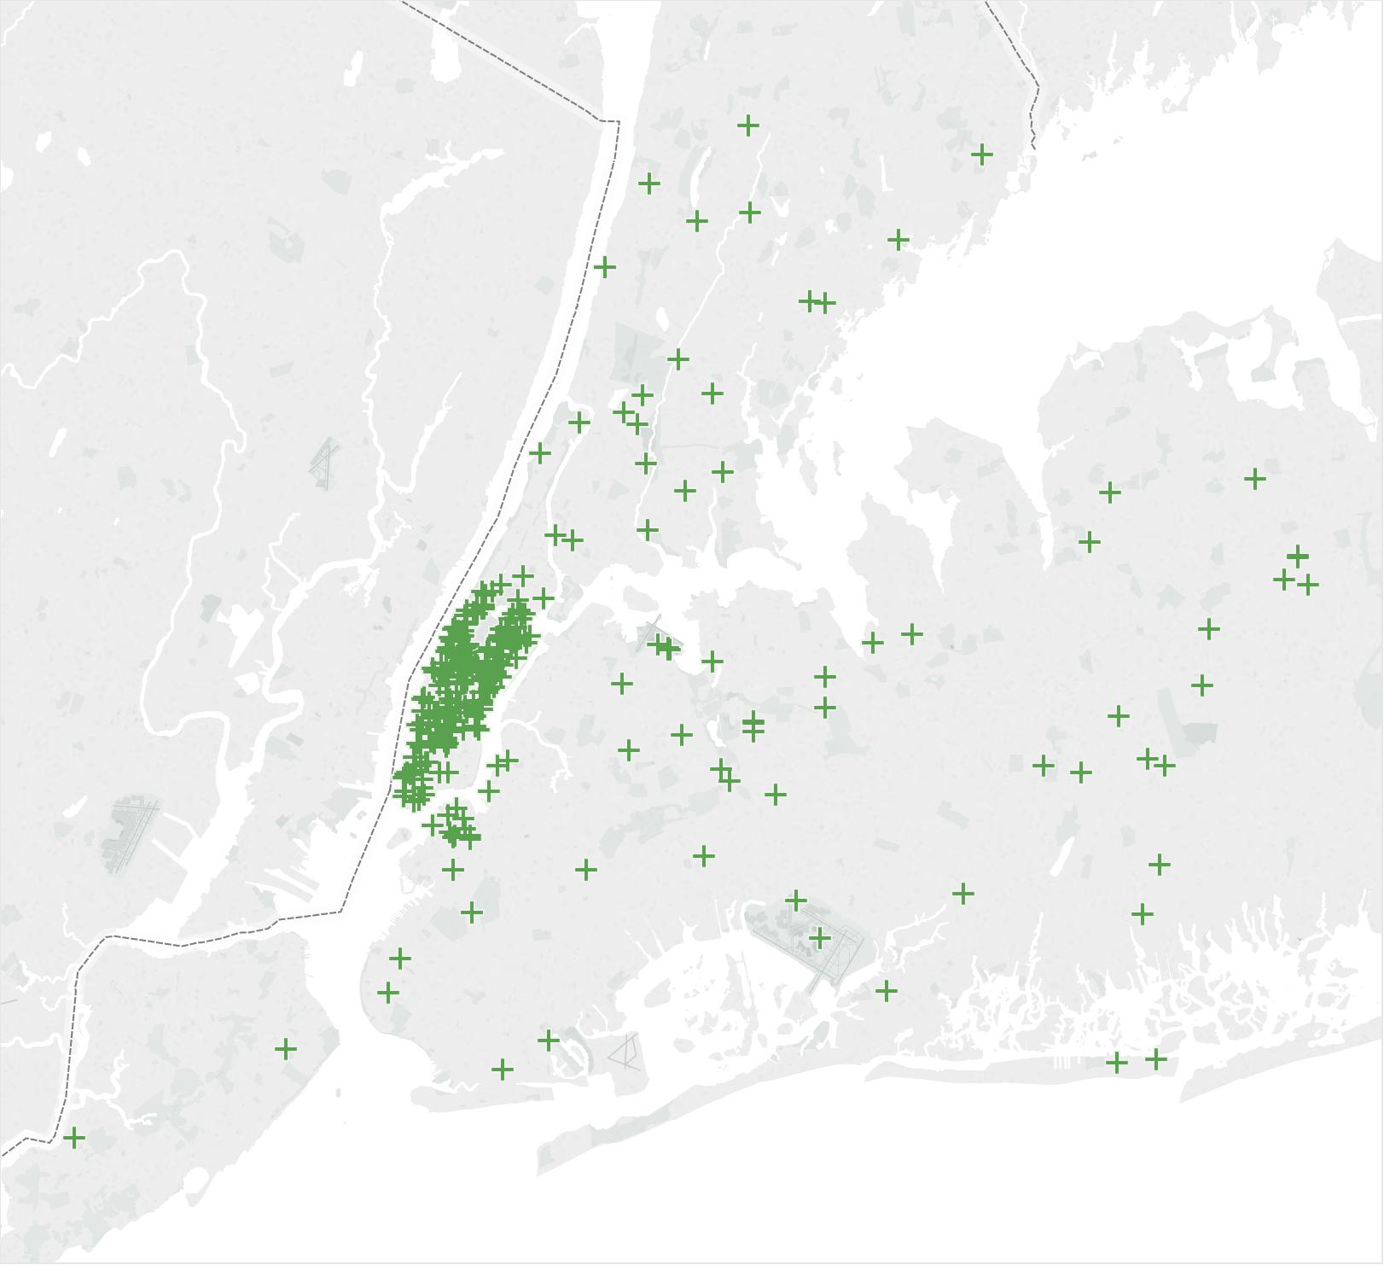
Charging Stations in NYC
310 charging stations;
assume 50 kW fast chargers.
Source: US DOE
Introduction | Simulation | Optimization | Results | Summary

Slide 7
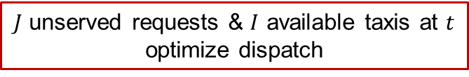

Simulation Process
generate 500 EAV taxis
keep initial locations & timestamps
set random initial SOC $∈$ [10%, 100%]
waiting
not assigned
$J$ unserved requests & $I$ available taxis at $t$
optimize dispatch
assigned
called
occupied
SOC≥10% at drop-off?
yes
no
going to charging stations
charging to 100% SOC
Introduction | Simulation | Optimization | Results | Summary

Slide 8


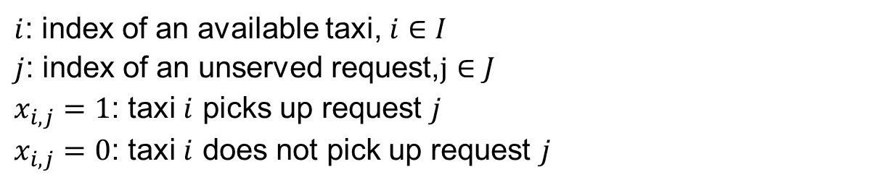
Decision Variables
$I$ available taxis and $J$ unserved requests at $t$
Define binary decision variables
$$x_{i,j}$$
$i$: index of an available taxi, $i∈I$
$j$: index of an unserved request,$j∈J$
$x_{i,j}=1$: taxi $i$ picks up request $j$
$x_{i,j}=0$: taxi $i$ does not pick up request $j$
Introduction | Simulation | Optimization | Results | Summary

Slide 9
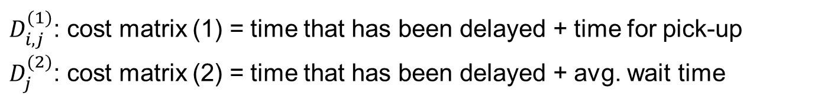
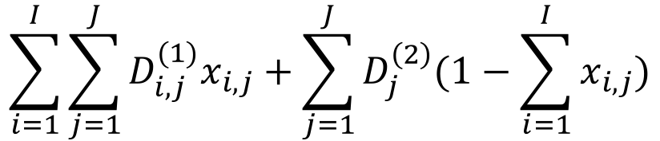
Objective Function
$$\sum_{i=1}^{I}{\sum_{j=1}^{J}{D_{i,j}^{(1)}x_{i,j}}}+\sum_{j=1}^{J}{D_{j}^{\left(2\right)}(1−\sum_{i=1}^{I}{x_{i,j}})}$$
minimize
total costs of the requests that can be served
total costs of the requests that cannot be served
$D_{i,j}^{(1)}$: cost matrix (1) = time that has been delayed + time for pick-up
$D_{j}^{(2)}$: cost matrix (2) = time that has been delayed + avg. wait time
differs by area
Introduction | Simulation | Optimization | Results | Summary

Slide 10






Constraints (1): Sufficient EV Range
calculate the distance matrix $L_{I×J}=L_{1}+L_{2}+L_{3}$
$$L_{3}$$
$$L_{2}$$
$$L_{1}$$
if $L_{i, j}$ > the taxi’s remaining range,
$$x_{i,j}=0$$
Introduction | Simulation | Optimization | Results | Summary
Notes:
Check whether SOC is enough.

Slide 11
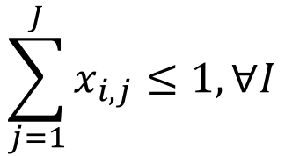
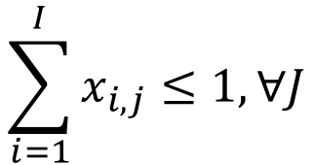
Constraints (2)
Each taxi will server at most one customer
$$\sum_{j=1}^{J}{x_{i,j}}≤1, ∀I$$
Each customer will be served by at most one taxi
$$\sum_{i=1}^{I}{x_{i,j}}≤1,∀J$$
Introduction | Simulation | Optimization | Results | Summary

Slide 12
Solver
Gurobi 7.5.1
integer linear programming (ILP)
1440 time intervals
CPU Intel E5-1620 3.70GHz, RAM 16GB
~40 minutes
Introduction | Simulation | Optimization | Results | Summary

Slide 13
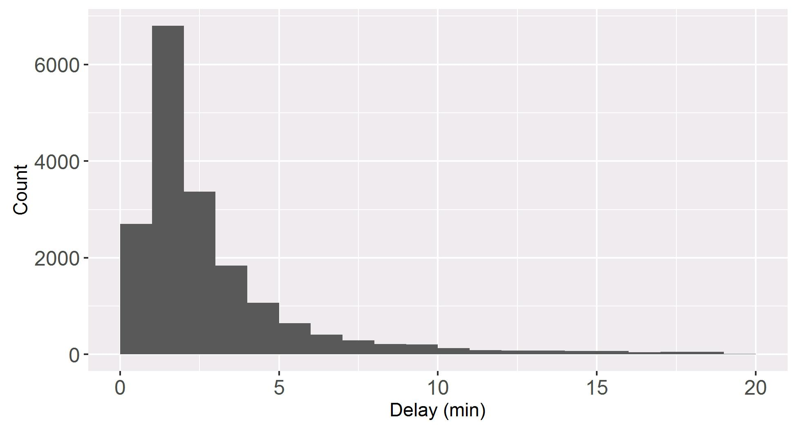
Customer Wait Time Distribution
Only 0.5% of requests are not served
Average wait time is 4.7 minutes
95% of requests are served within 11 minutes
Introduction | Simulation | Optimization | Results | Summary

Slide 14
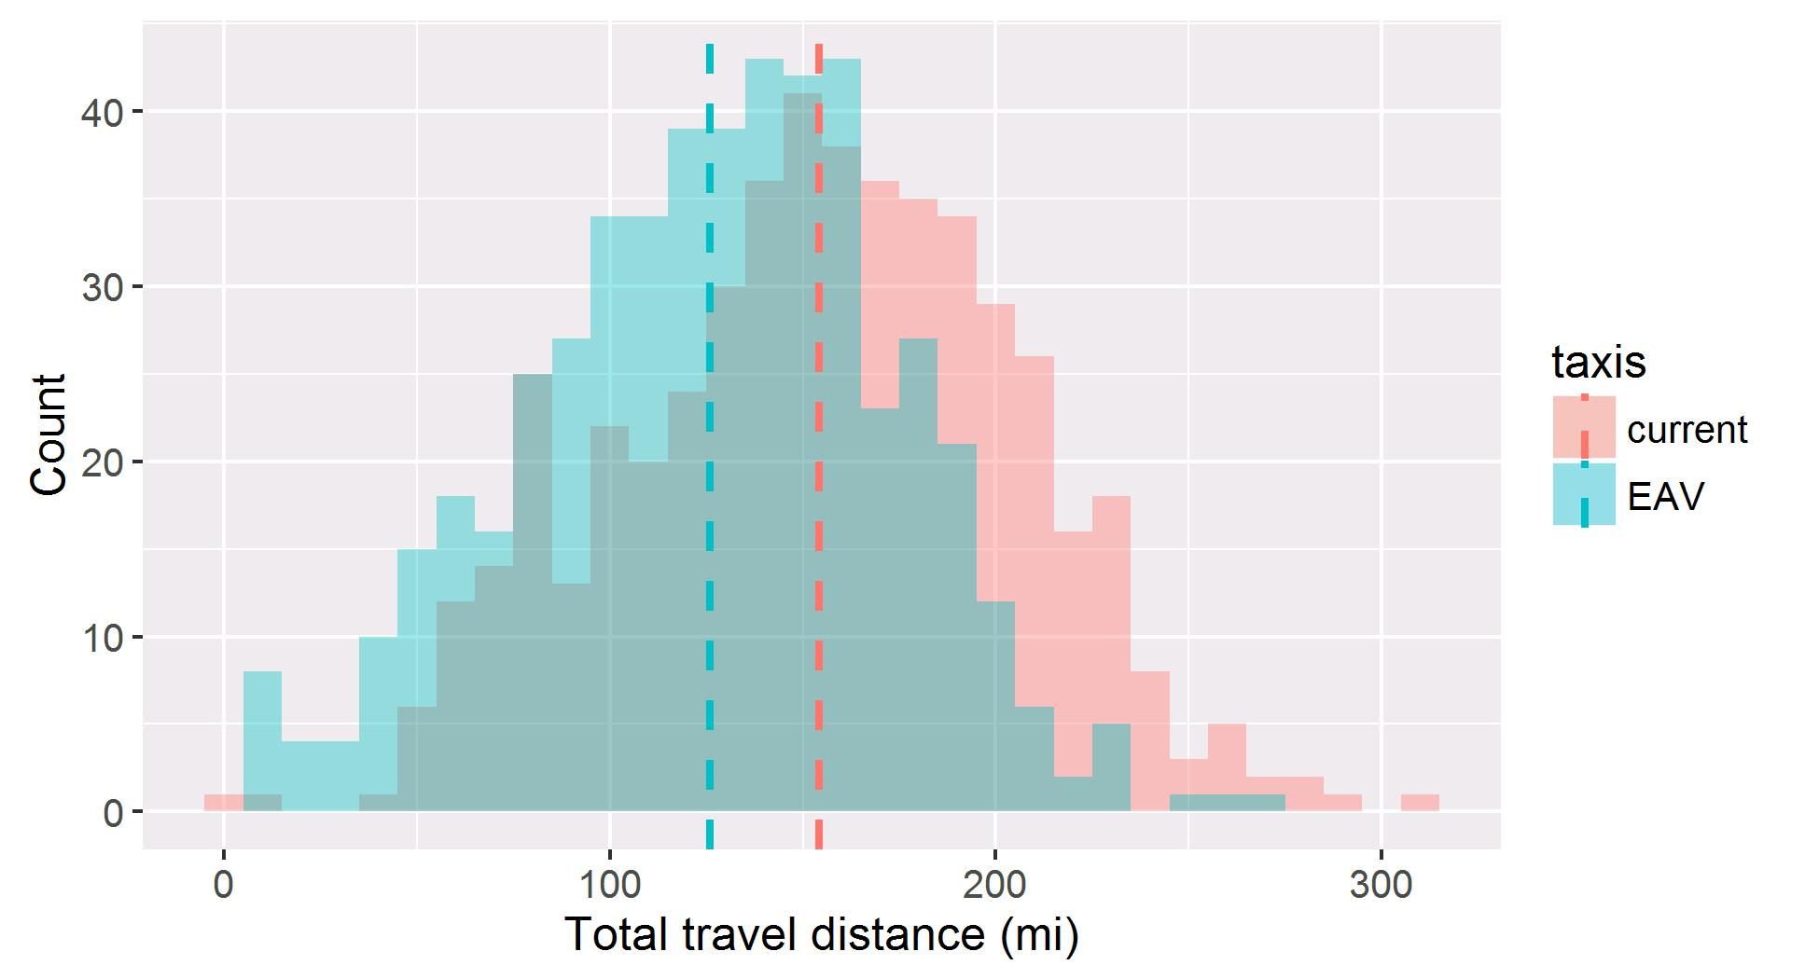
Total Travel Distance of Taxis
126 mi
154 mi
Average travel distance reduces by 18%
Introduction | Simulation | Optimization | Results | Summary

Slide 15
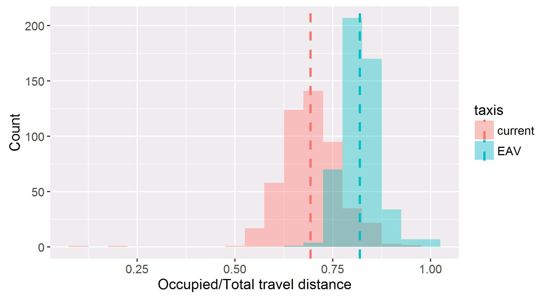
Ratio of Occupied/Total Travel Distance
69%
82%
EAV taxi system reduces empty trip distance from 49 mi to 23 mi
Average ratio of occupied distance increases from 69% to 82%
Introduction | Simulation | Optimization | Results | Summary

Slide 16
Implications of Fleet Size
Reduces fleet size by 5%~20%
Unserved requests remain at 0.5%~0.6%
Average delay is within 9 minutes when fleet size reduces by ≤15%
Average delay increases more significantly at 20% reduction
Introduction | Simulation | Optimization | Results | Summary

Slide 17
Implications of Fleet Size
current taxis: 154
With smaller fleet size, EAV taxis become busier
travel distance & ratio of occupied time increase almost linearly
Efficiency of current taxi system ≈ EAV taxis with 80% of fleet size
Ratio of occupied distance remains stable at 81%~82%
Introduction | Simulation | Optimization | Results | Summary

Slide 18
Implications of Electric Range
unserved requests: 0.5%
avg. delay: 4.6~4.8 min
avg. total travel dist.: 126 mi
Range does not have considerable implications on request delays nor efficiency of EAV taxi systems
avg. ratio of occupied dist.: 82%
avg. ratio of occupied time: 51%~52%
Introduction | Simulation | Optimization | Results | Summary
Notes:
Probably due to 50 kW fast charging.

Slide 19
Summary
EAV taxis improves efficiency of taxi systems
less empty trips
less energy consumption
EAV taxis has potential to reduce fleet size, while keep wait time at an acceptable level
average delay is within 9 min when the fleet size is reduced by 15%
Introduction | Simulation | Optimization | Results | Summary

Slide 20
Thank you
Corresponding author:
Dr. Jing Dong
jingdong@iastate.edu
Modeling the Operations of Electric Autonomous Taxis in New York City

